Slide 1
Implementation Guides
Lloyd McKenzie
August 21, 2019

Slide 2
FHIR Core specification
Defines all resources & Data types
Some terminology, most elements optional
Defines REST, messaging & document interfaces
Defines initial operations, search parameters
Framework for interoperability
But only “drive-by” actual interoperability

Slide 3
For full interoperability
We need:
Specific profiles setting constraints on resources & data types
What’s mandatory? What must be supported? What terminologies? What constraints?
Additional operations, search parameters
Guidance on what architectural approaches to use
Guidance on other things (security, consent, registration, etc.)
Examples of what data should actually look like

Slide 4
FHIR Implementation Guides
Implementation Guides:
Are packages of FHIR conformance resources relevant to solving a particular interoperability need
Also include additional human-readable documentation to guide implementation
Provide support for computable validation of solutions that claim conformance with the IG
Can build on other implementation guides
Are defined by a FHIR ImplementationGuide resource

Slide 5

Who produces IGs?
HL7 International
Other SDOs (e.g. IHE)
National & regional projects
Professional organizations
Implementation projects

Slide 6
Conformance Resources
Terminology
Code System
Value Set
Naming System
Content
Structure Definition
Behavior
Operation Definition
Search Parameter
Capability Statement
Misc.
Implementation Guide
Test Script
Structure Map
Concept Map
Message Definition
Graph Definition
Example Scenario

Slide 7
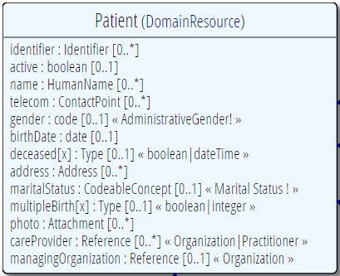
Profiling a resource
Demand that the identifier uses your national patient identifier
Limit names to just 1 (instead of 0..*)
Limit maritalStatus to another set of codes that extends the one from HL7 international
Add an extension to support “RaceCode”
Note: hardly any mandatory elements in the core spec!

Slide 8
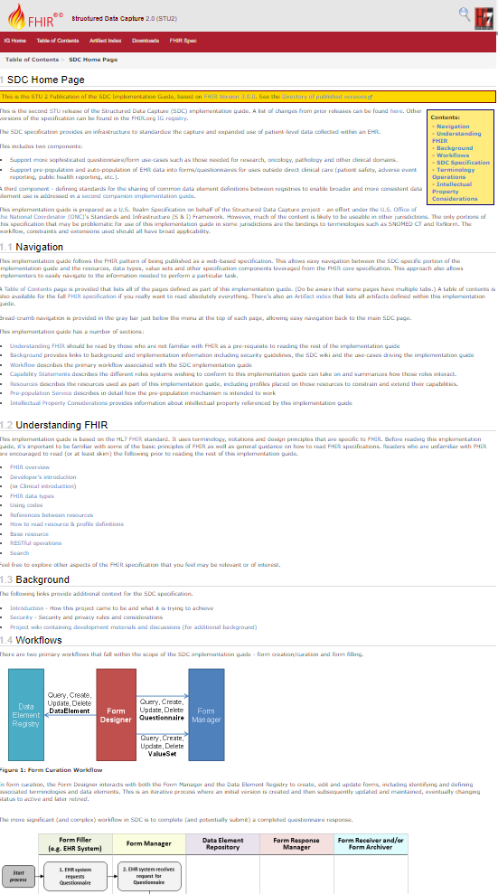
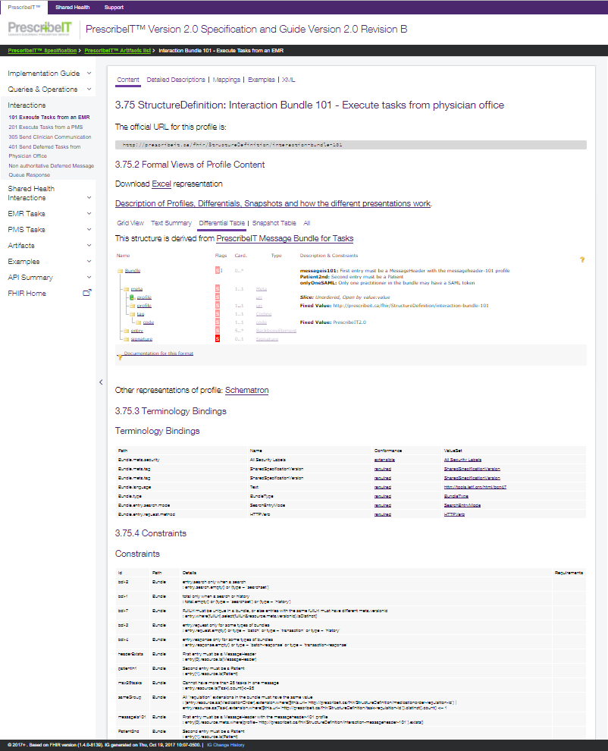
IG Inputs and Outputs
+ “Package”
ImplementationGuide
XHTML / Markdown
pages
Conformance
resources

Slide 9
Validation
Check that a FHIR instance complies with:
FHIR specification
Declared (and mandated) profiles
Current Code System & Value Set definitions
Requirements of referenced profiles & extensions

Slide 11
IG Creation & publishing
3 primary mechanisms
Simplifier
Relatively easy to author, little control over presentation
Trifolia
Web-based authoring environment
IG Publisher behind the scenes
HL7 IG Publisher
Very flexible, but can be hard to master
Forthcoming “template” approach will help
Notes:
10:00

Slide 12
Registries
HL7 maintains a registry of HL7 and other Igs
http://www.fhir.org/guides/registry/
HL7 also maintains a registry of profiles and other artifacts
http://registry.fhir.org
Firely maintains their own registry:
https://simplifier.net

Slide 13
What to look for in a FHIR IG
Profiles should define what “mustSupport” means and indicate what must be supported vs. not
Profiles should be careful about constraining maximum cardinalities
IGs should contain complete and well documented examples
Documentation should be clear and easy to follow

Slide 14


Questions?
http://hl7.org/fhir
lmckenzie@gevityinc.com

